Slide 1
Qualitative data is descriptive information (it describes something,non-numeric)
Quantitative data is numerical information (numbers,numeric)

Slide 2
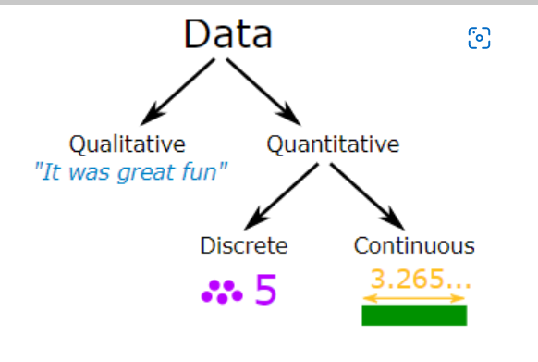

Slide 3
More Examples
Qualitative:
Ordinal(grade,rank)
nominal(gender,name of person)
Your friends' favorite holiday destination
The most common given names in your town
How people describe the smell of a new perfume

Slide 4
Quantitative:
Height (Continuous)
Weight (Continuous)
Petals on a flower (Discrete)
Customers in a shop (Discrete)

Slide 5
Quantitative data can be Discrete or Continuous:
Discrete data can only take certain values (like whole numbers)
Continuous data can take any value (within a range)
Put simply: Discrete data is counted, Continuous data is measured

Slide 6
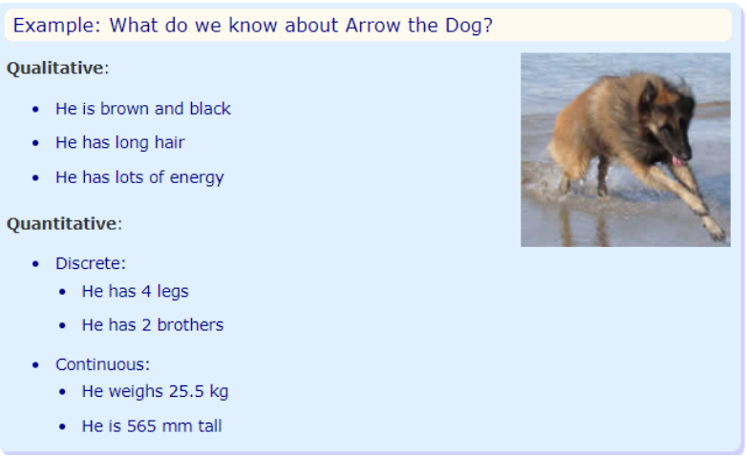

Slide 7
Statistics is a mathematical science including methods of collecting, organizing and analyzing data in such a way that meaningful conclusions can be drawn from them. In general, its investigations and analyses fall into two broad categories called descriptive and inferential statistics.

Slide 8
Descriptive statistics
Descriptive statistics are brief descriptive coefficients (a numerical or constant quantity placed before and multiplying the variable in an algebraic expression (e.g. 4 in 4x y))that summarize a given data set, which can be either a representation of the entire or a sample of a population.
Descriptive statistics are broken down into measures of central tendency and measures of variability (spread).

Slide 9
Measures of Central Value
When you have two or more numbers it is nice to find a value for the "center".
2 Numbers
With just 2 numbers the answer is easy: go half-way between.

Slide 10
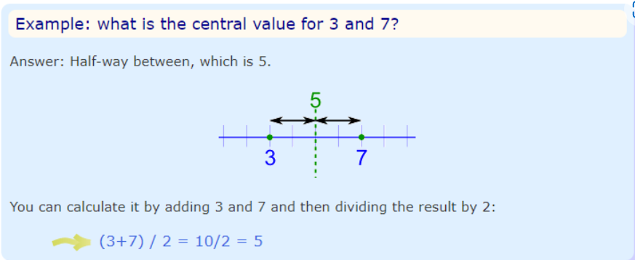

Slide 11
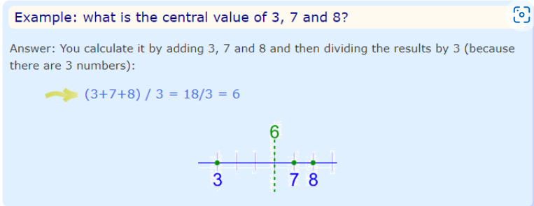
3 or More Numbers We can use that idea of "adding then dividing" when we have 3 or more numbers:
Notice that we divide by 3 because we have 3 numbers ... very important!

Slide 12
The Mean
The mean is the average of the numbers.
It is easy to calculate: add up all the numbers, then divide by how many numbers there are.
In other words it is the sum divided by the count.

Slide 13
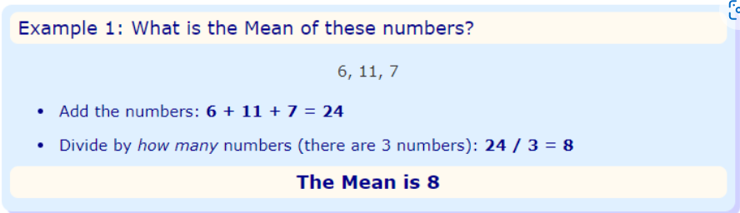

Slide 14
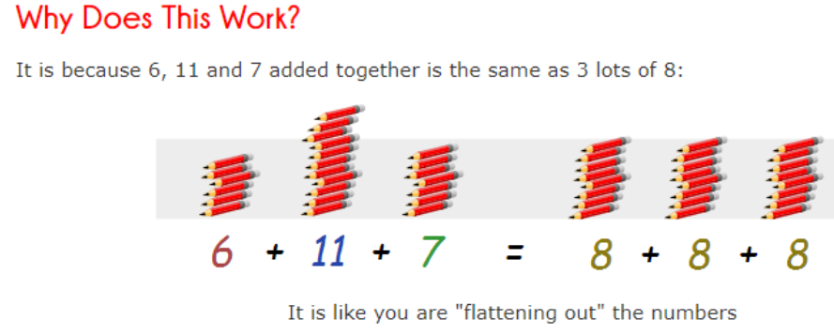

Slide 15
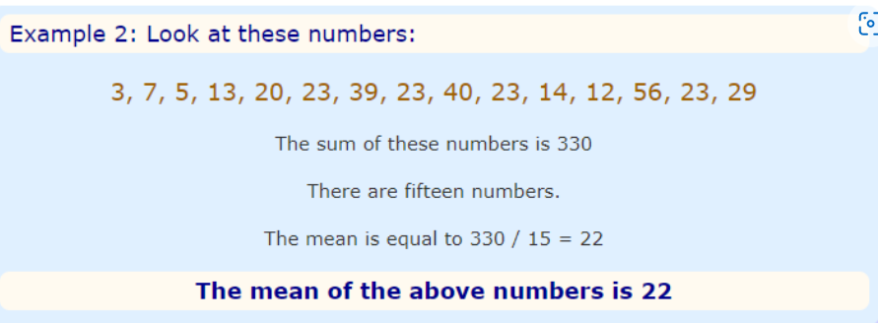

Slide 16
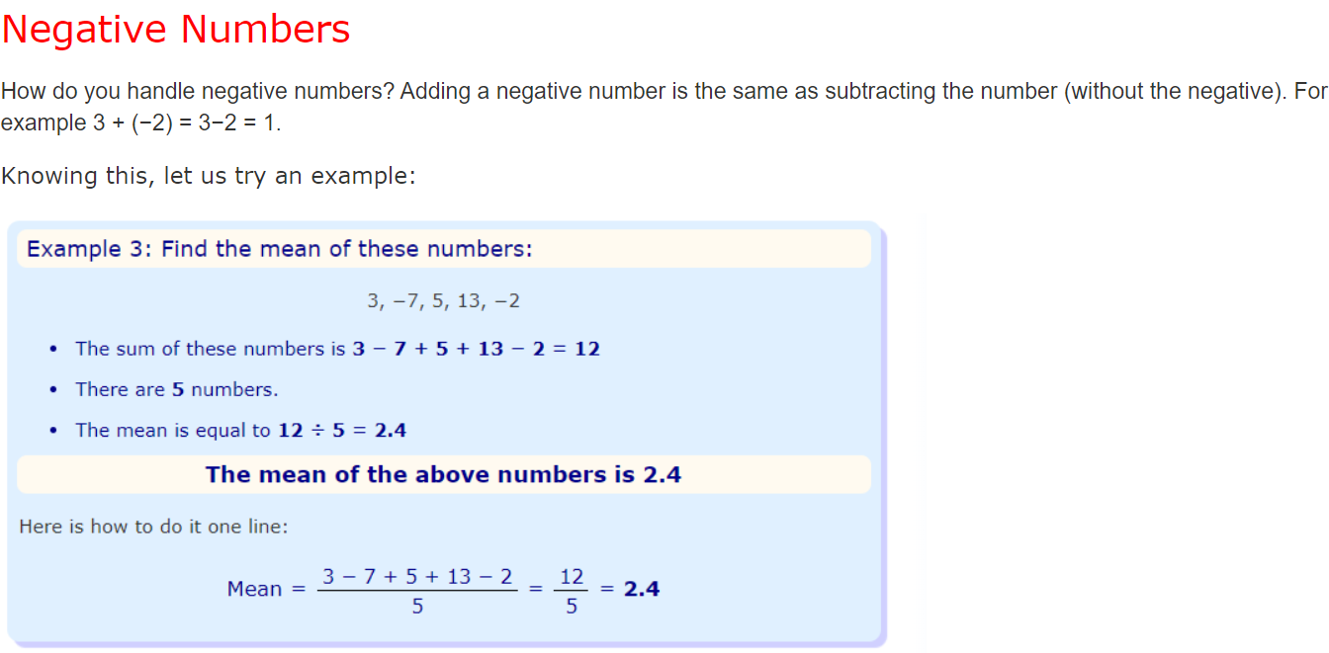

Slide 17
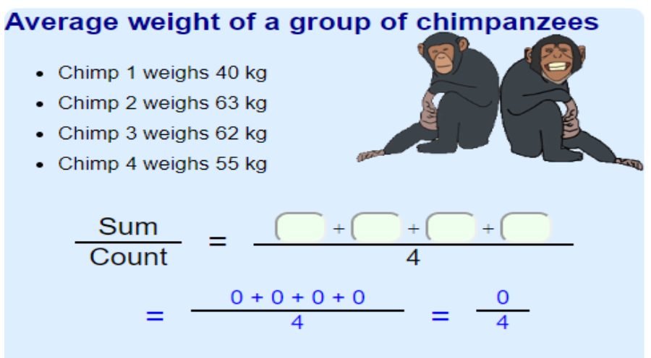

Slide 18
Median Value
The Median is the "middle" of a sorted list of numbers.
How to Find the Median Value
To find the Median, place the numbers in value order and find the middle.

Slide 19
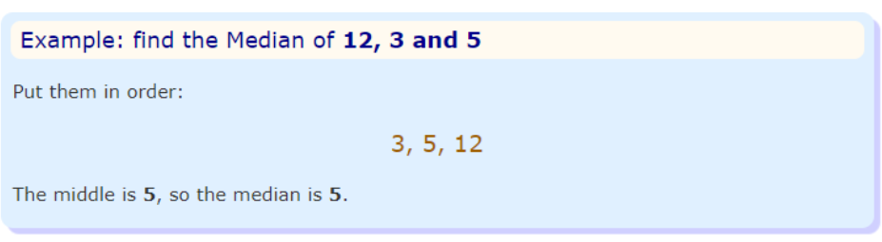

Slide 20
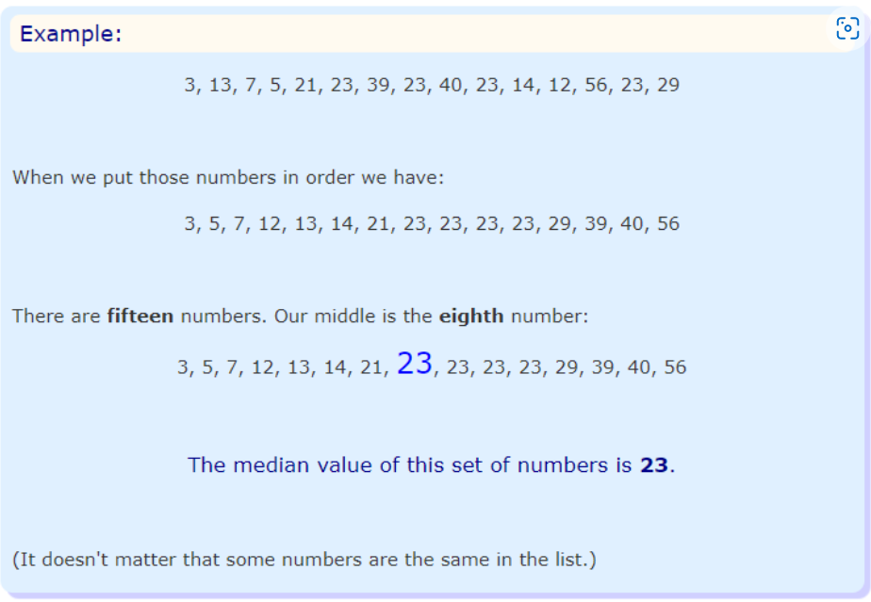

Slide 21
Two Numbers in the Middle
BUT, with an even amount of numbers things are slightly different.
In that case we find the middle pair of numbers, and then find the value that is halfway between them. This is easily done by adding them together and dividing by two.

Slide 22
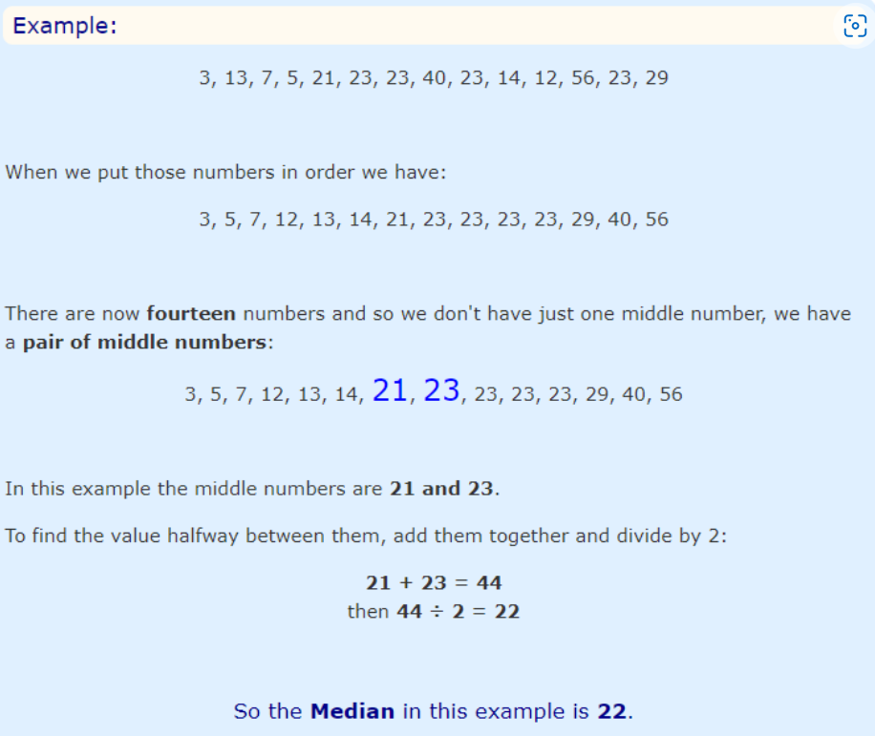

Slide 23
Where is the Middle?
A quick way to find the middle: count how many numbers, add 1 then divide by 2
Example: There are 45 numbers

Slide 24
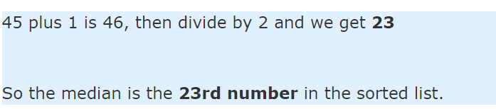
Example: There are 66 numbers
66 plus 1 is 67, then divide by 2 and we get 33.5
33 and a half? That means that the 33rd and 34th numbers in the sorted list are the two middle numbers.
So to find the median: add the 33rd and 34th numbers together and divide by 2.

Slide 25
Question
What is the median of the numbers 4, 2, 11, 6, 2, 9 ?
Answer
Put the numbers in order first: 2, 2, 4, 6, 9, 11
There are two numbers in the middle: 4 and 6.
The average of 4 and 6 is (4+6)/2 = 10/2 = 5
So the median is 5

Slide 26
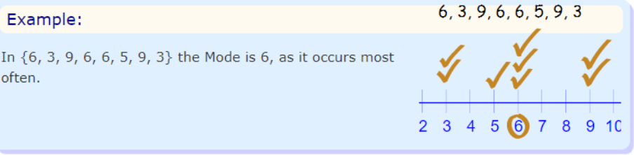
The Mode
“The mode is simply the number which appears most often.”

Slide 27
Finding the Mode
To find the mode, or modal value, it is best to put the numbers in order. Then count how many of each number. A number that appears most often is the mode.

Slide 28
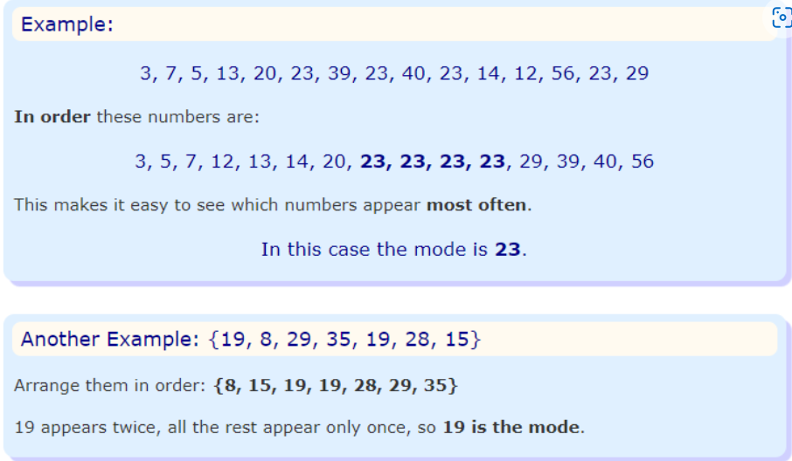

Slide 29
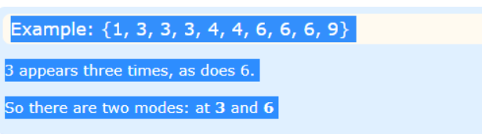
More Than One Mode
We can have more than one mode.
Example: {1, 3, 3, 3, 4, 4, 6, 6, 6, 9}
Having two modes is called "bimodal".
Having more than two modes is called "multimodal".

Slide 30
Measures of Spread
sometimes also called a measure of dispersion(how data is distributed)
It is used to describe the variability in a sample or population.
It is usually used in conjunction with a measure of central tendency,
such as the mean or median,
To provide an overall description of a set of data.
(used in quantitative data)

Slide 31
Type of MEasure of Spread
Range
Quartiles Range
Interquartile Range
Percentile
Mean Deviation
Standard deviation and Variance

Slide 32
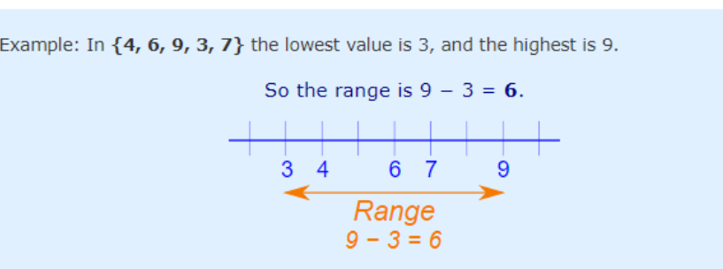
The Range (Statistics)
The Range is the difference between the lowest and highest values.

Slide 33
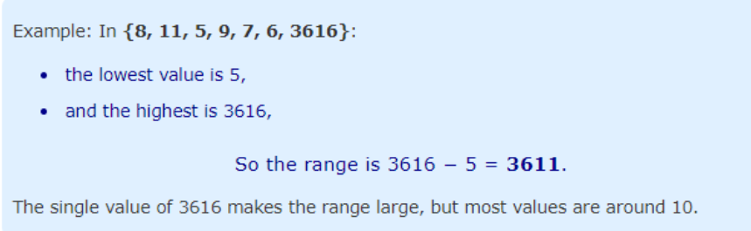
The Range Can Be Misleading
The range can sometimes be misleading when there are extremely high or low values.

Slide 34
So we may be better off using Interquartile Range or Standard Deviation.
Quartiles
Quartiles are the values that divide a list of numbers into quarters:
Put the list of numbers in order
Then cut the list into four equal parts
The Quartiles are at the "cuts"
Like this:

Slide 35
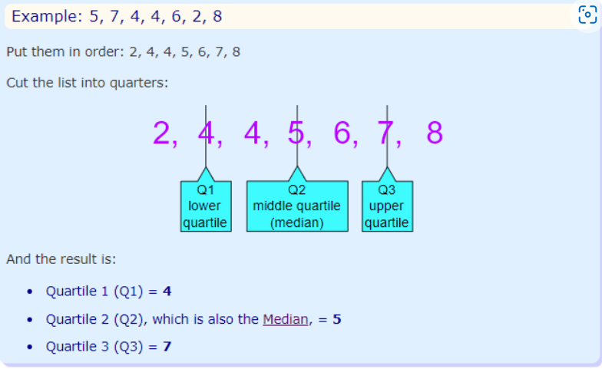
Sometimes a "cut" is between two numbers ... the Quartile is the average of the two numbers.

Slide 36
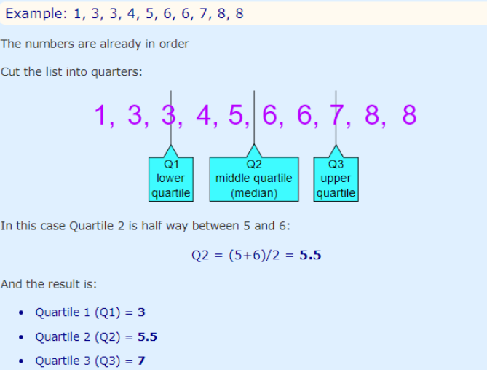

Slide 37
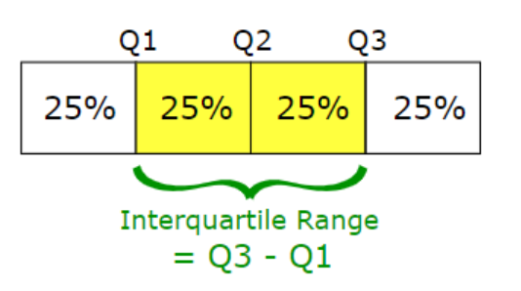

Interquartile Range The "Interquartile Range" is from Q1 to Q3:

Slide 38
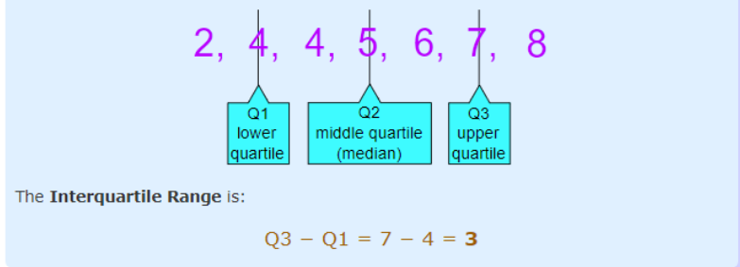
To calculate it just subtract Quartile 1 from Quartile 3, like this:

Slide 39
Interquartile range gives another measure of variability. It is a better measure of dispersion than range because it leaves out the extreme values. It equally divides the distribution into four equal parts called quartiles. First 25% is 1st quartile (Q1), last one is 3rd quartile (Q3) and middle one is 2nd quartile (Q2).
2nd quartile (Q2) divides the distribution into two equal parts of 50%. So, basically it is same as Median.

Slide 40
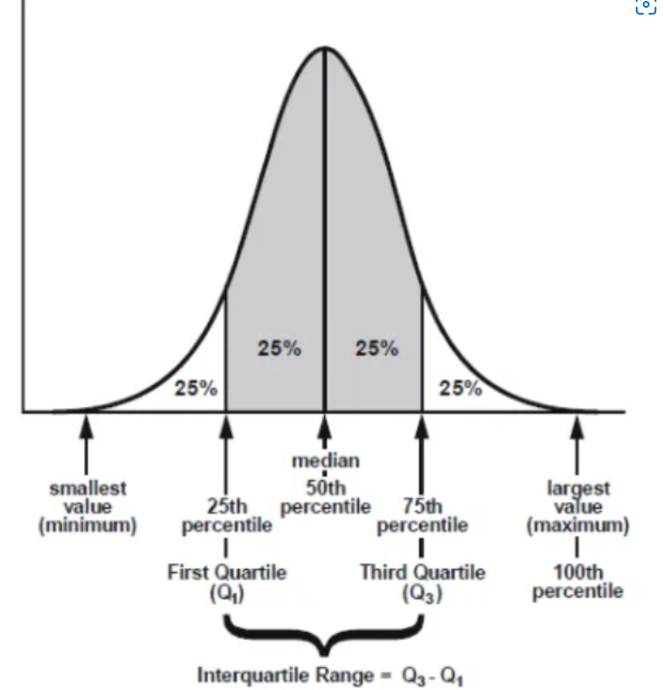

Slide 41
The interquartile range is the distance between the third and the first quartile, or, in other words, IQR equals Q3 minus Q1
IQR = Q3- Q1
How to calculate IQR
Step 1: Order from low to high
Step 2: Find the median or in other words Q2
Step 3: Then find Q1 by looking the median of the left side of Q2
Steps 4: Similarly find Q3 by looking the median of the right of Q2
Steps 5: Now subtract Q1 from Q3 to get IQR.

Slide 42
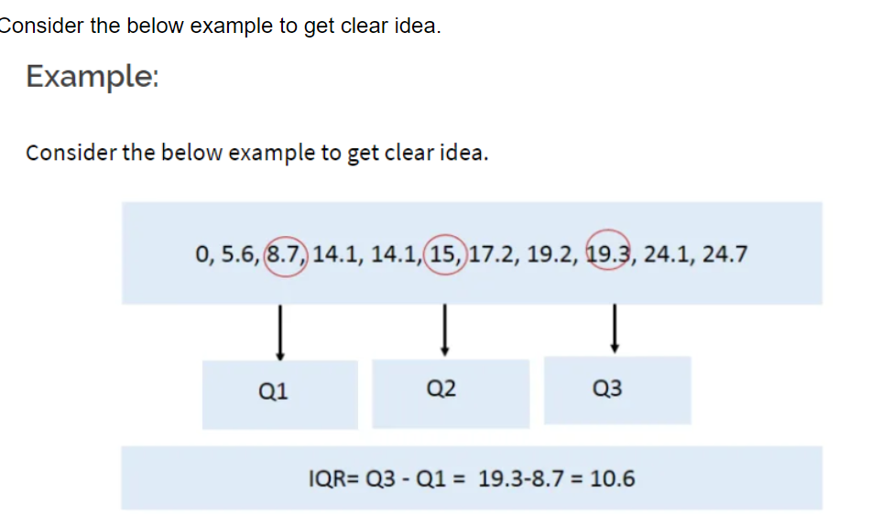

Slide 43
Consider another example to get better understanding.
Consider the following numbers: 1, 3, 4, 5, 5, 6, 7, 11. Q1 is the middle value in the first half of the data set. Since there are an even number of data points in the first half of the data set, the middle value is the average of the two middle values; that is, Q1 = (3 + 4)/2 or Q1 = 3.5. Q3 is the middle value in the second half of the data set. Again, since the second half of the data set has an even number of observations, the middle value is the average of the two middle values; that is, Q3 = (6 + 7)/2 or Q3 = 6.5. The interquartile range is Q3 minus Q1, so IQR = 6.5 – 3.5 = 3.

Slide 44
Advantage of IQR:
The main advantage of the IQR is that it is not affected by outliers because it doesn’t take into account observations below Q1 or above Q3.
It might still be useful to look for possible outliers in your study.
As a rule of thumb, observations can be qualified as outliers when they lie more than 1.5 IQR below the first quartile or 1.5 IQR above the third quartile.
Outliers = Q1 – 1.5* IQR OR
=Q3 + 1.5*IQR

Slide 45
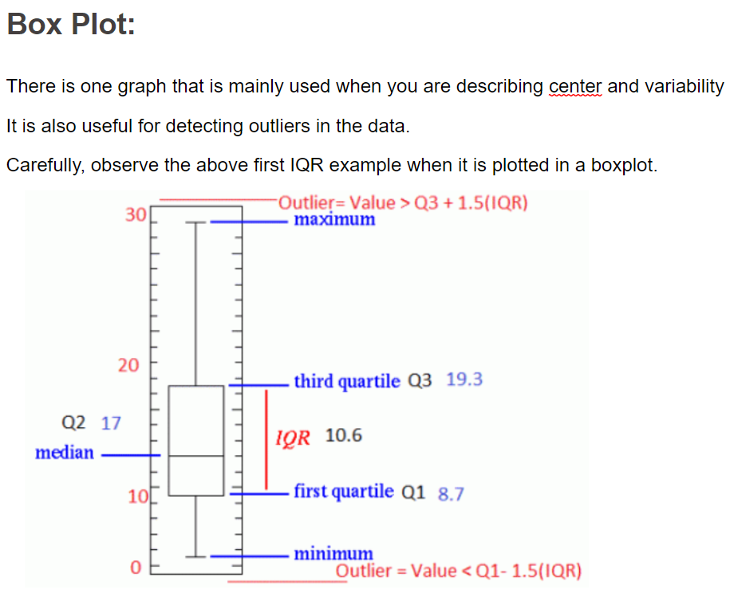

Slide 46
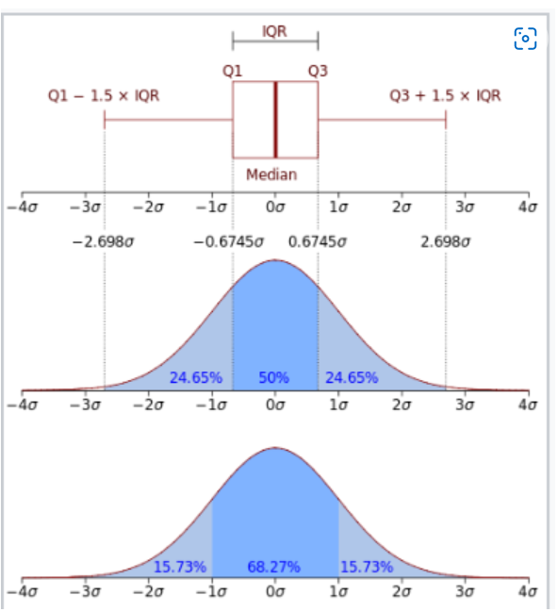

Slide 47
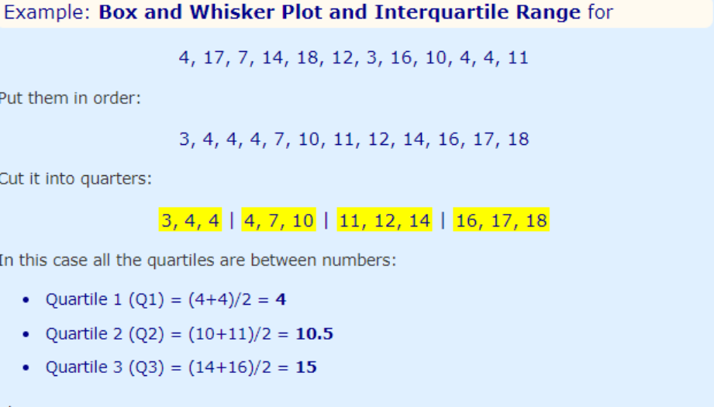

Slide 48
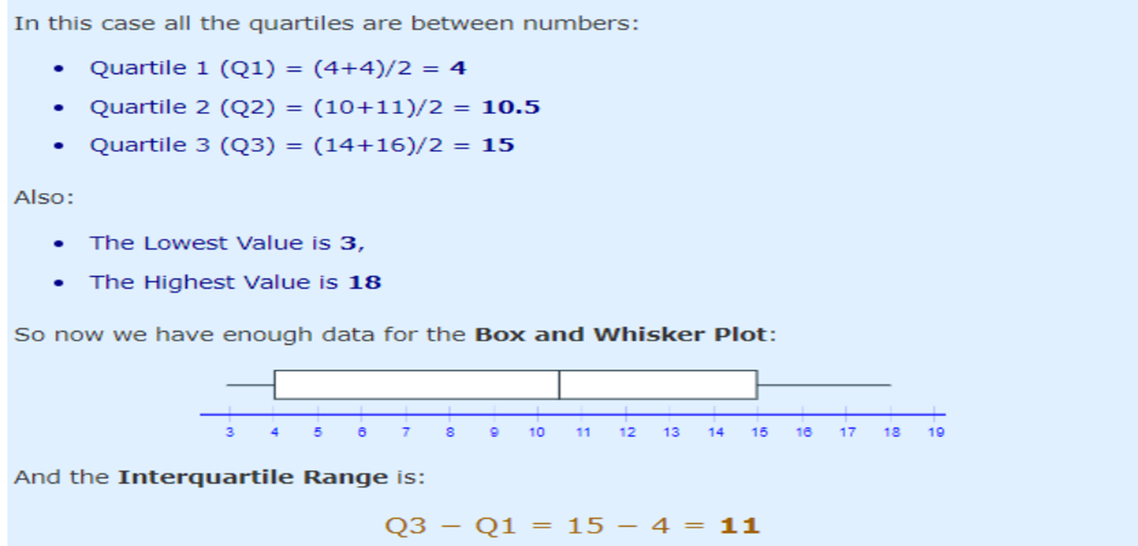

Slide 49
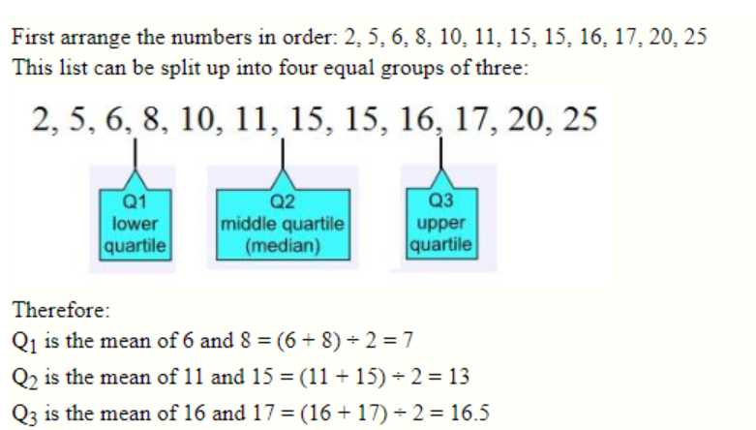
Question
What are the quartiles for the following set of numbers?
8, 11, 20, 10, 2, 17, 15, 5, 16, 15, 25, 6

Slide 50
Question
What are the quartiles for the following set of numbers?
13, 18, 6, 20, 25, 11, 9, 18, 3, 30, 16, 9, 8, 23, 26, 17

Slide 51
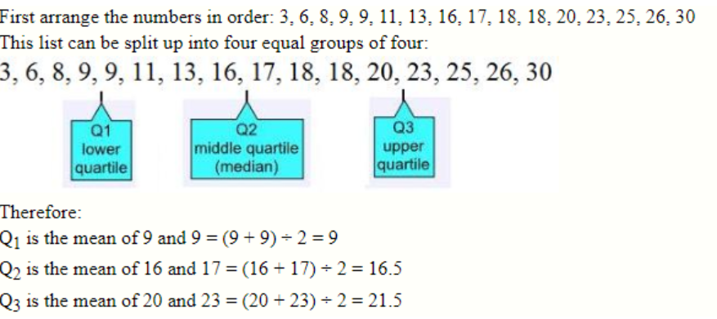

Slide 52
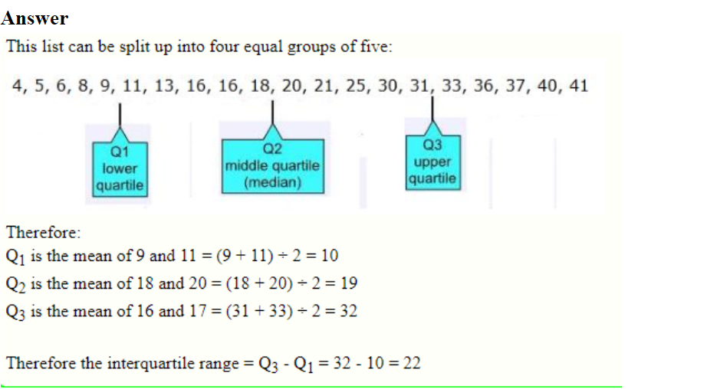
What is the interquartile range for the following set of numbers?
4, 5, 6, 8, 9, 11, 13, 16, 16, 18, 20, 21, 25, 30, 31, 33, 36, 37, 40, 41

Slide 53
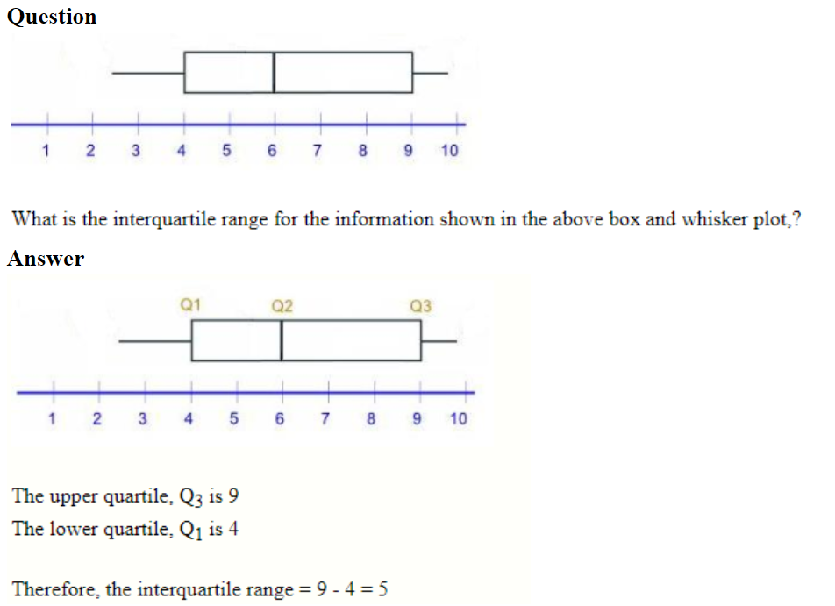

Slide 54
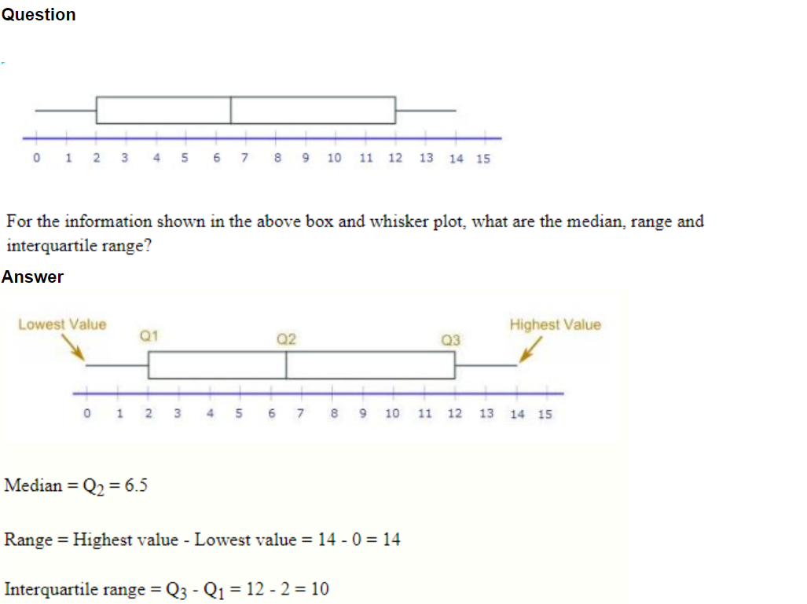

Slide 55
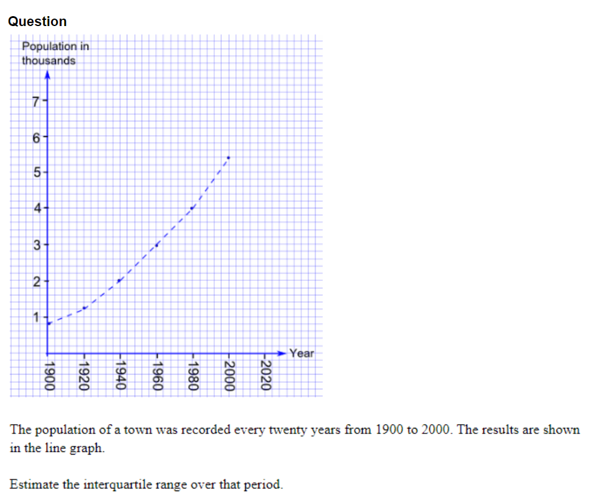

Slide 56
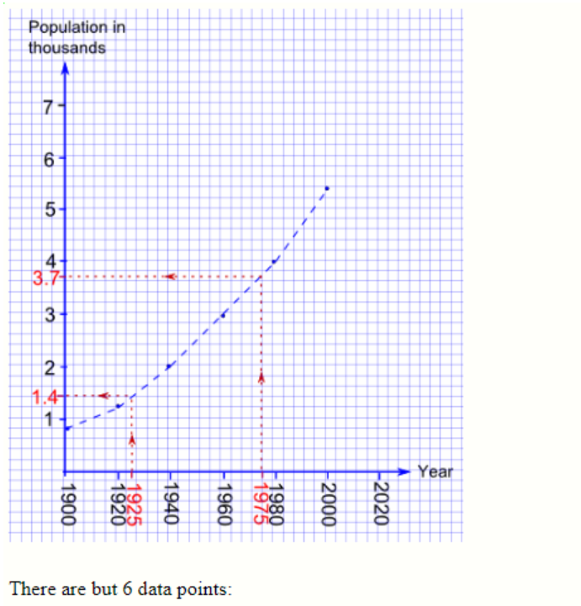

Slide 57
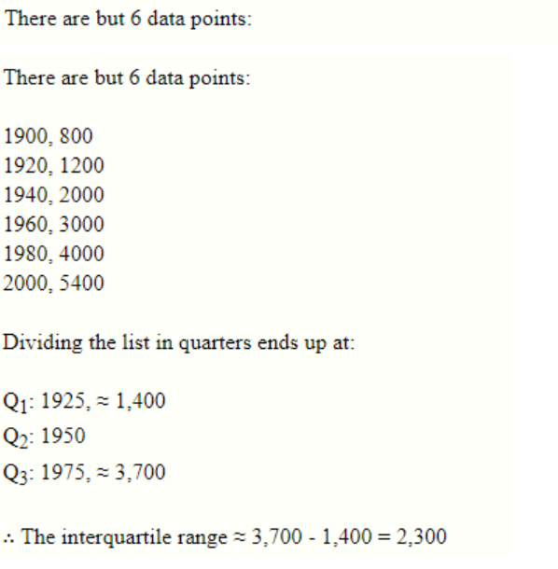

Slide 58
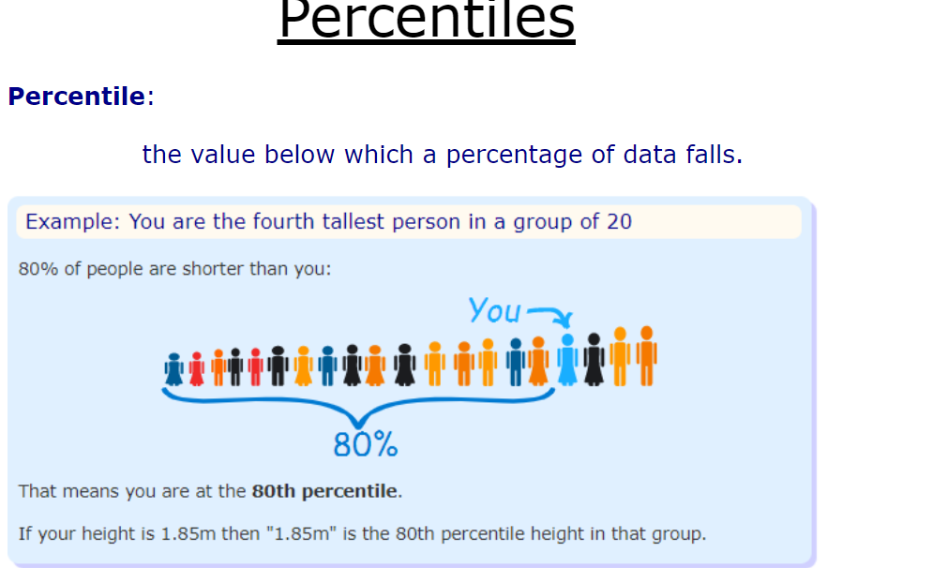

Slide 59
In Order
Have the data in order, so you know which values are above and below.
To calculate percentiles of height: have the data in height order (sorted by height).
To calculate percentiles of age: have the data in age order.
And so on.

Slide 60
Grouped Data
When the data is grouped:
Add up all percentages below the score.
plus half the percentage at the score.

Slide 61
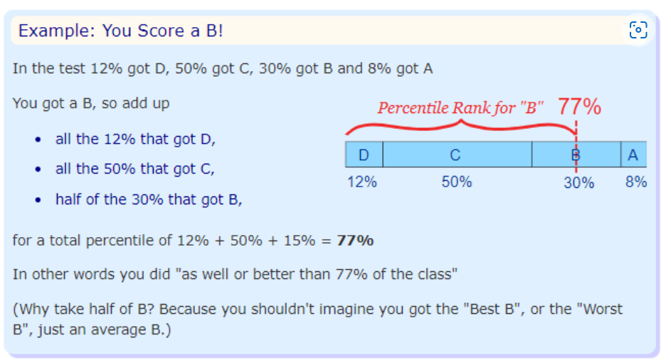

Slide 62
Deciles
Deciles are similar to Percentiles (sounds like decimal and percentile together), as they split the data into 10% groups:
The 1st decile is the 10th percentile (the value that divides the data so that 10% is below it)
The 2nd decile is the 20th percentile (the value that divides the data so that 20% is below it)
etc!

Slide 63
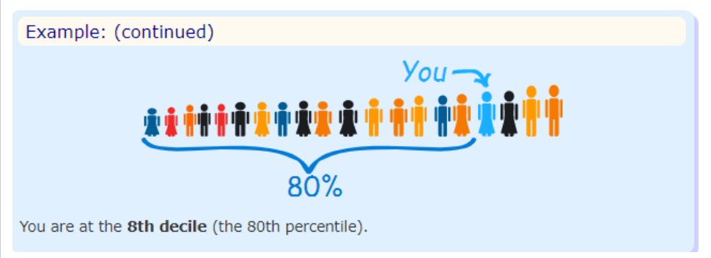

Slide 64
Quartiles
Another related idea is Quartiles, which splits the data into quarters:

Slide 65
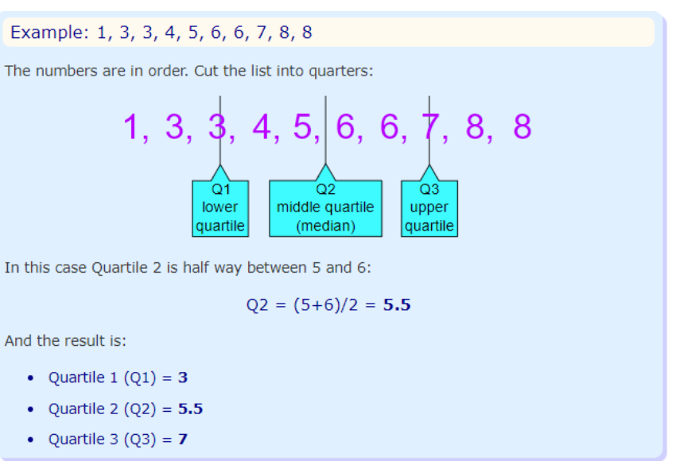

Slide 66
The Quartiles also divide the data into divisions of 25%, so:
Quartile 1 (Q1) can be called the 25th percentile
Quartile 2 (Q2) can be called the 50th percentile
Quartile 3 (Q3) can be called the 75th percentile

Slide 67
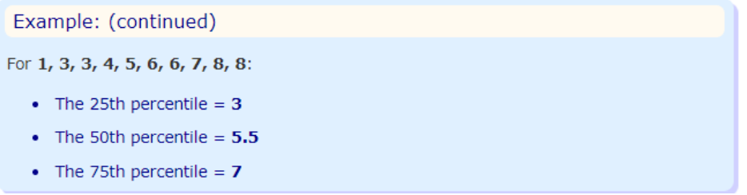

Slide 68
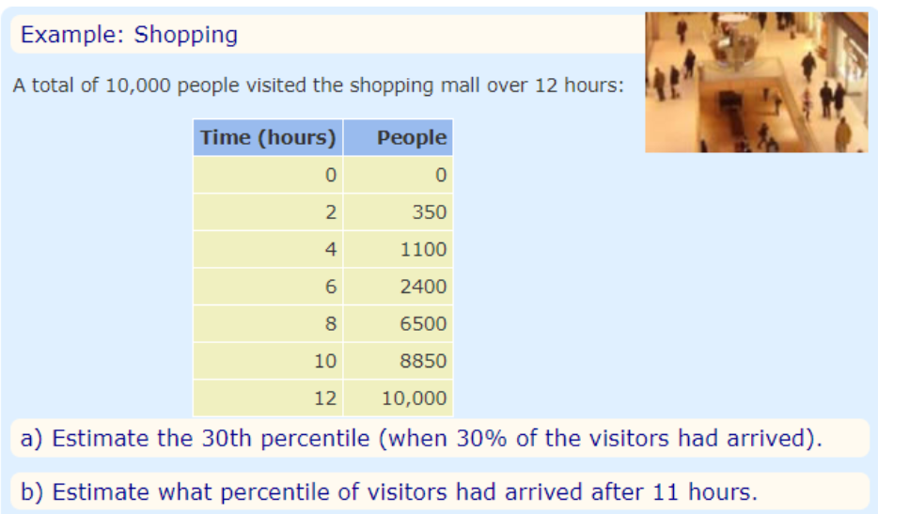
Estimating Percentiles
We can estimate percentiles from a line graph.

Slide 69
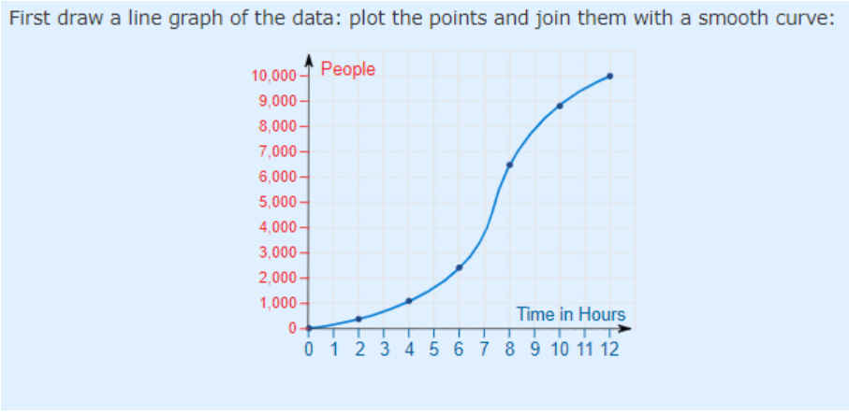

Slide 70
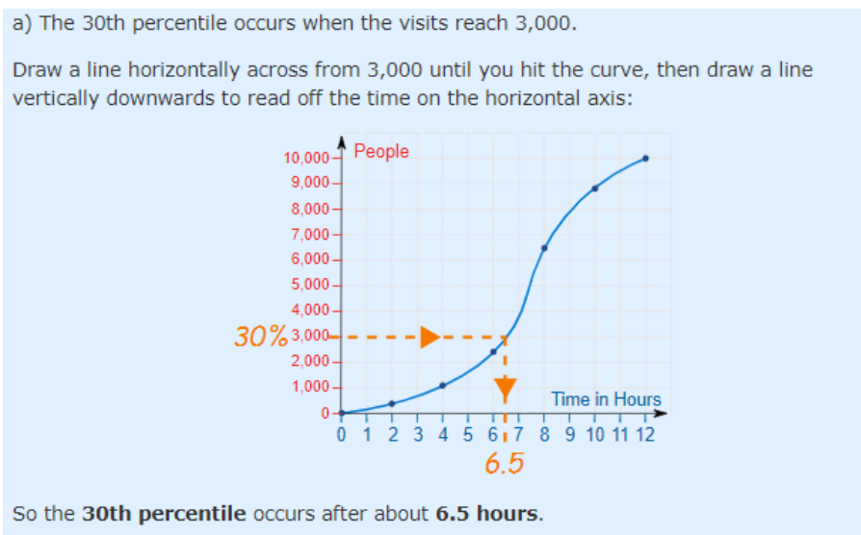

Slide 71
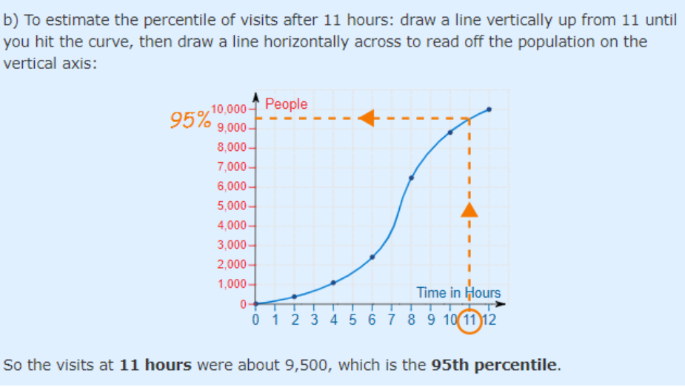

Slide 72
Mean Deviation
How far, on average, all values are from the middle.
The mean deviation is the first measure of dispersion that we will use that actually uses each data value in its computation.
It is the mean of the distances between each value and the mean.
It gives us an idea of how spread out from the center the set of values is.

Slide 73
Calculating It
Find the mean of all values ... use it to work out distances ... then find the mean of those distances!
In three steps:
1. Find the mean of all values
2. Find the distance of each value from that mean (subtract the mean from each value, ignore minus signs)
3. Then find the mean of those distances

Slide 74
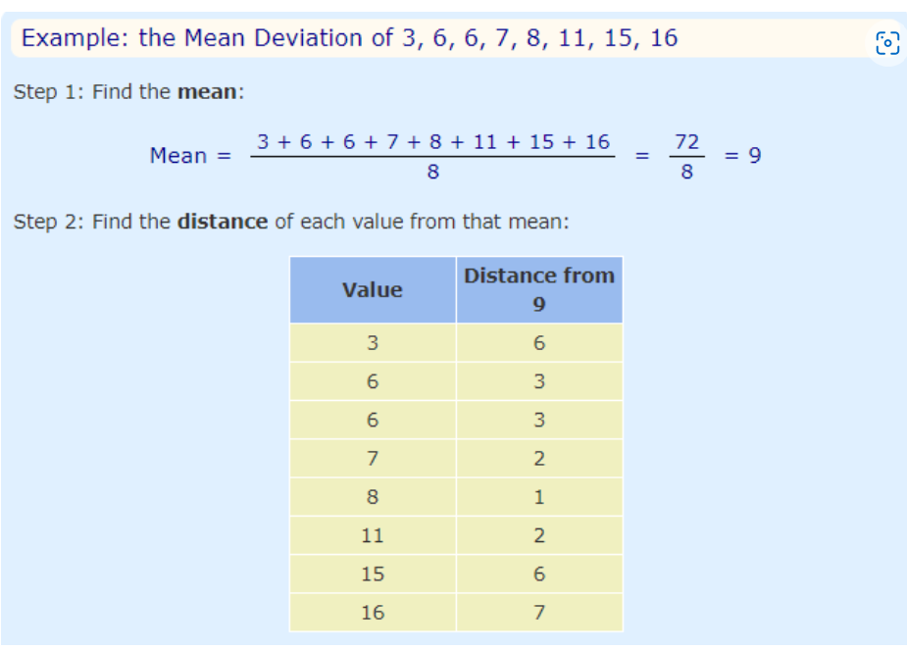

Slide 75
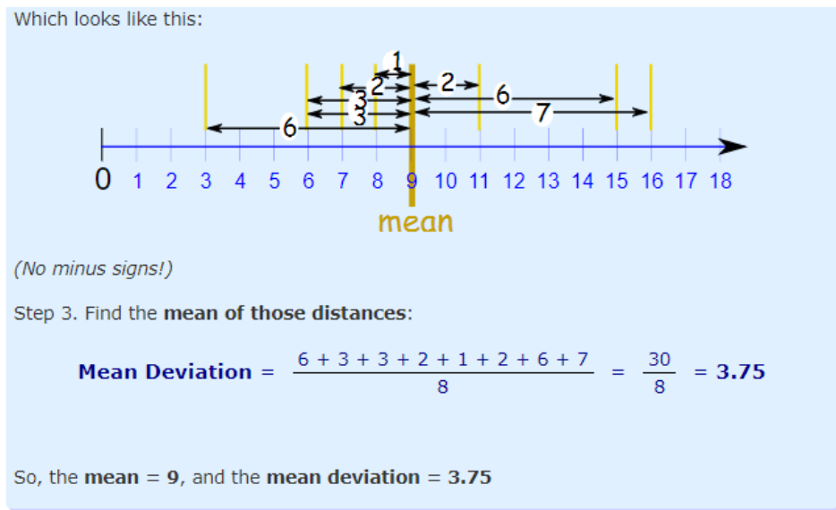

Slide 76
It tells us how far, on average, all values are from the middle.
In that example the values are, on average, 3.75 away from the middle.
Deviation = Distance

Slide 77
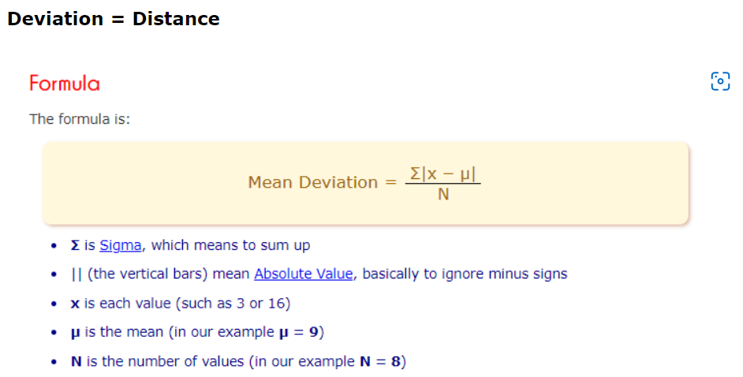

Slide 78
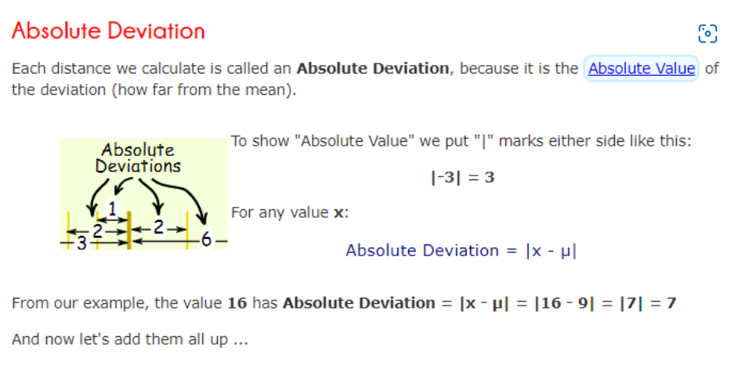

Slide 79
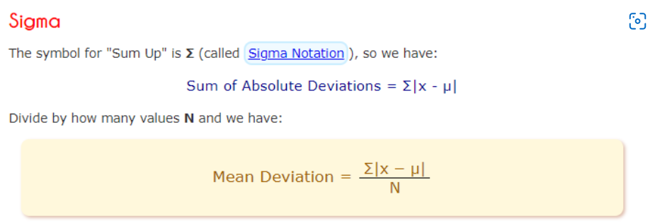
Let's do our example again, using the proper symbols:

Slide 80
What Does It "Mean" ?
Mean Deviation tells us how far, on average, all values are from the middle.
Here is an example :

Slide 81


Slide 82


Slide 83


Slide 84
A Useful Check
The deviations on one side of the mean should equal the deviations on the other side.
From our first example:

Slide 85


Slide 86


Slide 87
Question :1
Calculate the mean deviation for the numbers: 75, 83, 96, 100, 121 and 125
Answer

Slide 88


Slide 89
Question:2
Ten friends scored the following marks in their end-of-year math exam:
23%, 37%, 45%, 49%, 56%, 63%, 63%, 70%, 72% and 82%
What was the mean deviation of their marks?

Slide 90


Slide 91


Slide 92


Slide 93

Question :4
What is the mean deviation of the first 10 numbers of the Fibonacci sequence?
Answer

Slide 94
Standard Deviation and Variance
Deviation just means how far from the normal
Standard Deviation
The Standard Deviation is a measure of how spread out numbers are.
Its symbol is σ (the greek letter sigma)
The formula is easy: it is the square root of the Variance. So now you ask, "What is the Variance?"

Slide 95
Variance
The Variance is defined as:
The average of the squared differences from the Mean.
To calculate the variance follow these steps:
Work out the Mean (the simple average of the numbers)
Then for each number: subtract the Mean and square the result (the squared difference).
Then work out the average of those squared differences.

Slide 96


Slide 97


Slide 98


Slide 99


Slide 100


Slide 101


Slide 102


Slide 103


Slide 104


Slide 105


Slide 106


Slide 107


Slide 108


Slide 109


Slide 110


Slide 111


Slide 112


Slide 113


Slide 114


Slide 115


Slide 116


Slide 117


Slide 118


Slide 119


Slide 120


Slide 121
Answer
1. Firstly find the mean
Mean = (75 + 83 + 96 + 100 + 121 + 125) ÷ 6 = 600 ÷ 6 = 100
2. Next find the variance. To calculate the Variance, take each difference, square it, and then average the result:
(75 - 100)2 + (83 - 100)2 + (96 - 100)2 + (100 - 100)2 + (121 - 100)2 + (125 - 100)2
= (-25)2 + (-17)2 + (-4)2 + (0)2 + (21)2 + (25)2
= 625 + 289 + 16 + 0 + 441 + 625
= 1,996
So the Variance = 1,996 ÷ 6 = 332.66...
3. The Standard Deviation is just the square root of the Variance
= √(332.66...)
= 18.2 correct to 1 decimal places

Slide 122
Example :3
Ten friends scored the following marks in their end-of-year math exam:
23%, 37%, 45%, 49%, 56%, 63%, 63%, 70%, 72% and 82%
What was the standard deviation of their marks?

Slide 123
Firstly find the mean:
Mean = (23 + 37 + 45 + 49 + 56 + 63 + 63 + 70 + 72 + 82) ÷ 10 = 560 ÷ 10 = 56
2. Next find the variance. To calculate the Variance, take each difference, square it, and then average the result:
(23 - 56)2 + (37 - 56)2 + (45 - 56)2 + (49 - 56)2 + (56 - 56)2 + (63 - 56)2 + (63 - 56)2 + (70 - 56)2 + (72 - 56)2 + (82 - 56)2
= (-33)2 + (-19)2 + (-11)2 + (-7)2 + (0)2 + (7)2 + (7)2 + (14)2 + (16)2 + (26)2
= 1,089 + 361 + 121 + 49 + 0 + 49 + 49 + 196 + 256 + 676
= 2,846
So the Variance = 2,846 ÷ 10 = 284.6
3. The Standard Deviation is just the square root of the Variance
= √(284.6)
= 16.9 correct to 1 decimal place

Slide 124
Example :4
A booklet has 12 pages with the following numbers of words:
271, 354, 296, 301, 333, 326, 285, 298, 327, 316, 287 and 314
What is the standard deviation number of words per page?

Slide 125
1. Firstly find the mean number of words per page:
Mean = (271 + 354 + 296 + 301 + 333 + 326 + 285 + 298 + 327 + 316 + 287 + 314) ÷ 12
= 3,708 ÷ 12
= 309
2. Next find the variance. To calculate the Variance, take each difference, square it, and then average the result:
(271 - 309)2 + (354 - 309)2 + (296 - 309)2 + (301 - 309)2 + (333 - 309)2 + (326 - 309)2 + (285 - 309)2 + (298 - 309)2 + (327 - 309)2 + (316 - 309)2 + (287 - 309)2 + (314 - 309)2
= (-38)2 + (45)2 + (-13)2 + (-8)2 + (24)2 + (17)2 + (-24)2 + (-11)2 + (18)2 + (7)2 + (-22)2 + (5)2
= 1,444 + 2,025 + 169 + 64 + 576 + 289 + 576 + 121 + 324 + 49 + 484 + 25
= 6,146
So the Variance = 6,146 ÷ 12 = 512.166...
3. The Standard Deviation is just the square root of the Variance
= √(512.166...)
= 22.6 correct to 1 decimal place

Slide 126
Normal Distribution

